Slide 1
Monitoring COVID-19 Patients Using Cardio-Pulmonary Stethoscope RF Technology:
Computer Simulation Study Using CT Scans of Patients
MAGDY F. ISKANDER, CHRISTOPHER LEONG, PRATIKSHA SHUKLA, SCOTT CLEMENS, AND ZHENGQING YUN
Labiba Tasfiya Jeba
ID: 22266028

Slide 2
Table of Contents
1 Summary
1.1 Purpose
1.2 Contribution
1.3 Methodology
1.4 Conclusion
2 Limitations
2.1 First Limitation
2.2 Second Limitation
3 Synthesis

Slide 3
1.1 Purpose
Imaging methods such as CT scans and X-rays are used to monitor COVID-19 disease progression but have limitations.
Cardio-pulmonary stethoscope (CPS) use to continuously monitor COVID-19 patients.
CPS uses RF signals to measure S-parameters between sensors placed on the patient's chest
Monitor COVID-19 patients by detecting changes in lung tissue dielectric properties associated with inflammation.

Slide 4
1.2 Contribution
Problem Definition
Current methods for detecting and monitoring COVID-19 infections are expensive, time-consuming, and expose patients to radiation.
Develop new method for detecting and monitoring COVID-19 infections using capacitively coupled sensors (CPS).

Slide 5
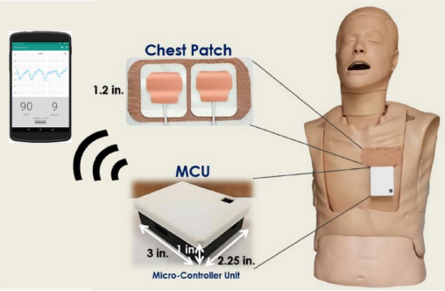
Figure: CPS system with chest patch, microcontroller unit, and mobile
application.

Slide 6
1.3 Methodology
Modeled COVID-19 infection in the lungs of a digital human model in HFSS.
HFSS is an ellipsoid with a radius of 11.45 mm.
Placed the infection in the lower peripheral area of the lung
Simulate CPS measuring the S-parameters of the infected lungs for varying states of lung water content

Slide 7
1.4 Conclusion
CPS detect infections as small as 5.45 mm in diameter, even in lungs with severe edema (60% LWC).
CPS able to detect infections that were located away from the sensor,
CPS was more sensitive to infections in lungs with lower LWC (20% and 40%).
CPS can detect small infections that were hidden from the direct line of sight of the sensor.

Slide 8
Limitation
2
1
Diversity of Human Models
Assumption of Initial Imaging

Slide 9
3 Synthesis
A good example of how these tools can be used to develop and evaluate new medical technologies.
The authors' use of simulation and modeling for several reasons-
It allowed them to evaluate the performance of the CPS device without having to conduct clinical trials.
Allowed them to test the CPS device in a variety of conditions.
The simulation results provided valuable insights into how the CPS device works and how it is affected by different factors. This information can be used to improve the design of the CPS device and to develop protocols for using the device in clinical settings.

Slide 10
Thank You

